Slide 1
Jerusalem Controversies:
A Rock of Offense
2024 Quarter 3 Lesson 09
Mark 11&12

Slide 2
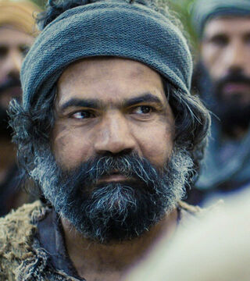
The Triumphal Entry
Mark 11:1-11
And when they came nigh to Jerusalem, unto Bethphage and Bethany, at the mount of Olives, he sendeth forth two of his disciples,

Slide 3
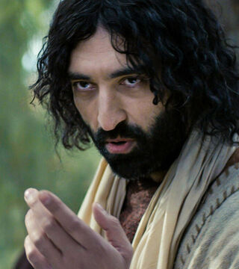
The Triumphal Entry
Mark 11:2-11
2 And saith unto them, Go your way into the village over against you: and as soon as ye be entered into it, ye shall find a colt tied, whereon never man sat; loose him, and bring him.

Slide 4
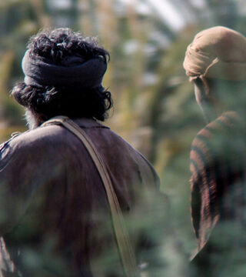
The Triumphal Entry
Mark 11:3-11
3 And if any man say unto you, Why do ye this? say ye that the Lord hath need of him; and straightway he will send him hither.

Slide 5
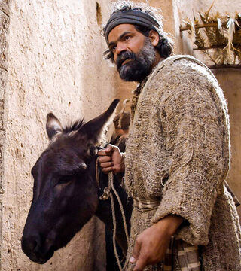
The Triumphal Entry
Mark 11:4-11
4 And they went their way, and found the colt tied by the door without in a place where two ways met; and they loose him.

Slide 6
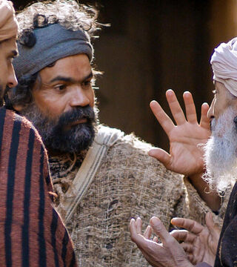
The Triumphal Entry
Mark 11:5-11
5 And certain of them that stood there said unto them, What do ye, loosing the colt?
6 And they said unto them even as Jesus had commanded: and they let them go.

Slide 7
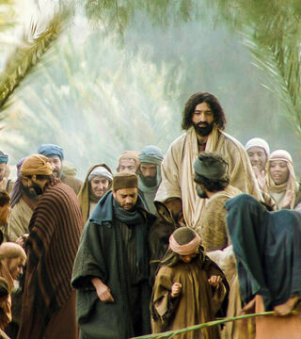
The Triumphal Entry
Mark 11:7-11
7 And they brought the colt to Jesus, and cast their garments on him; and he sat upon him.

Slide 8
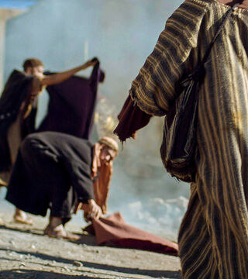
The Triumphal Entry
Mark 11:8-11
8 And many spread their garments in the way: and others cut down branches off the trees, and strawed them in the way.

Slide 9
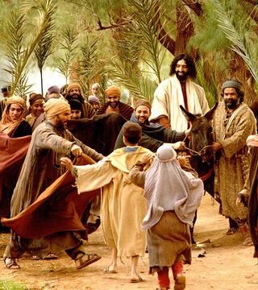
The Triumphal Entry
Mark 11:9-11
9 And they that went before, and they that followed, cried, saying, Hosanna; Blessed is he that cometh in the name of the Lord:

Slide 10
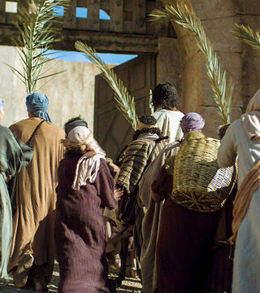
The Triumphal Entry
Mark 11:10-11
10 Blessed be the kingdom of our father David, that cometh in the name of the Lord: Hosanna in the highest.

Slide 11
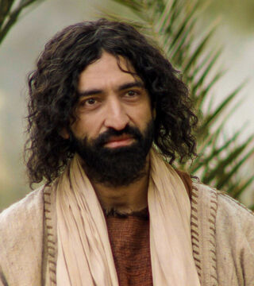
The Triumphal Entry
Mark 11:11
11 And Jesus entered into Jerusalem, and into the temple: and when he had looked round about upon all things, and now the eventide was come, he went out unto Bethany with the twelve.

Slide 12
The Desire of Ages, p. 572
“
“Many Pharisees witnessed the scene, and, burning with envy and malice, sought to turn the current of popular feeling. With all their authority they tried to silence the people; but their appeals and threats only increased the enthusiasm.”
”

Slide 13
The Desire of Ages, p. 572
“
“They feared that this multitude, in the strength of their numbers, would make Jesus king. As a last resort they pressed through the crowd to where the Saviour was, and accosted Him with reproving and threatening words: “Master, rebuke Thy disciples.”
”

Slide 14
The Desire of Ages, p. 572
“
They declared that such noisy demonstrations were unlawful, and would not be permitted by the authorities. But they were silenced by the reply of Jesus, “I tell you that, if these should hold their peace, the stones would immediately cry out.”
”

Slide 15
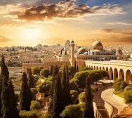
The Desire of Ages
Pg. 575
“When the procession reached the brow of the hill, and was about to descend into the city, Jesus halted, and all the multitude with Him. Before them lay Jerusalem in its glory, now bathed in the light of the declining sun.”

Slide 16
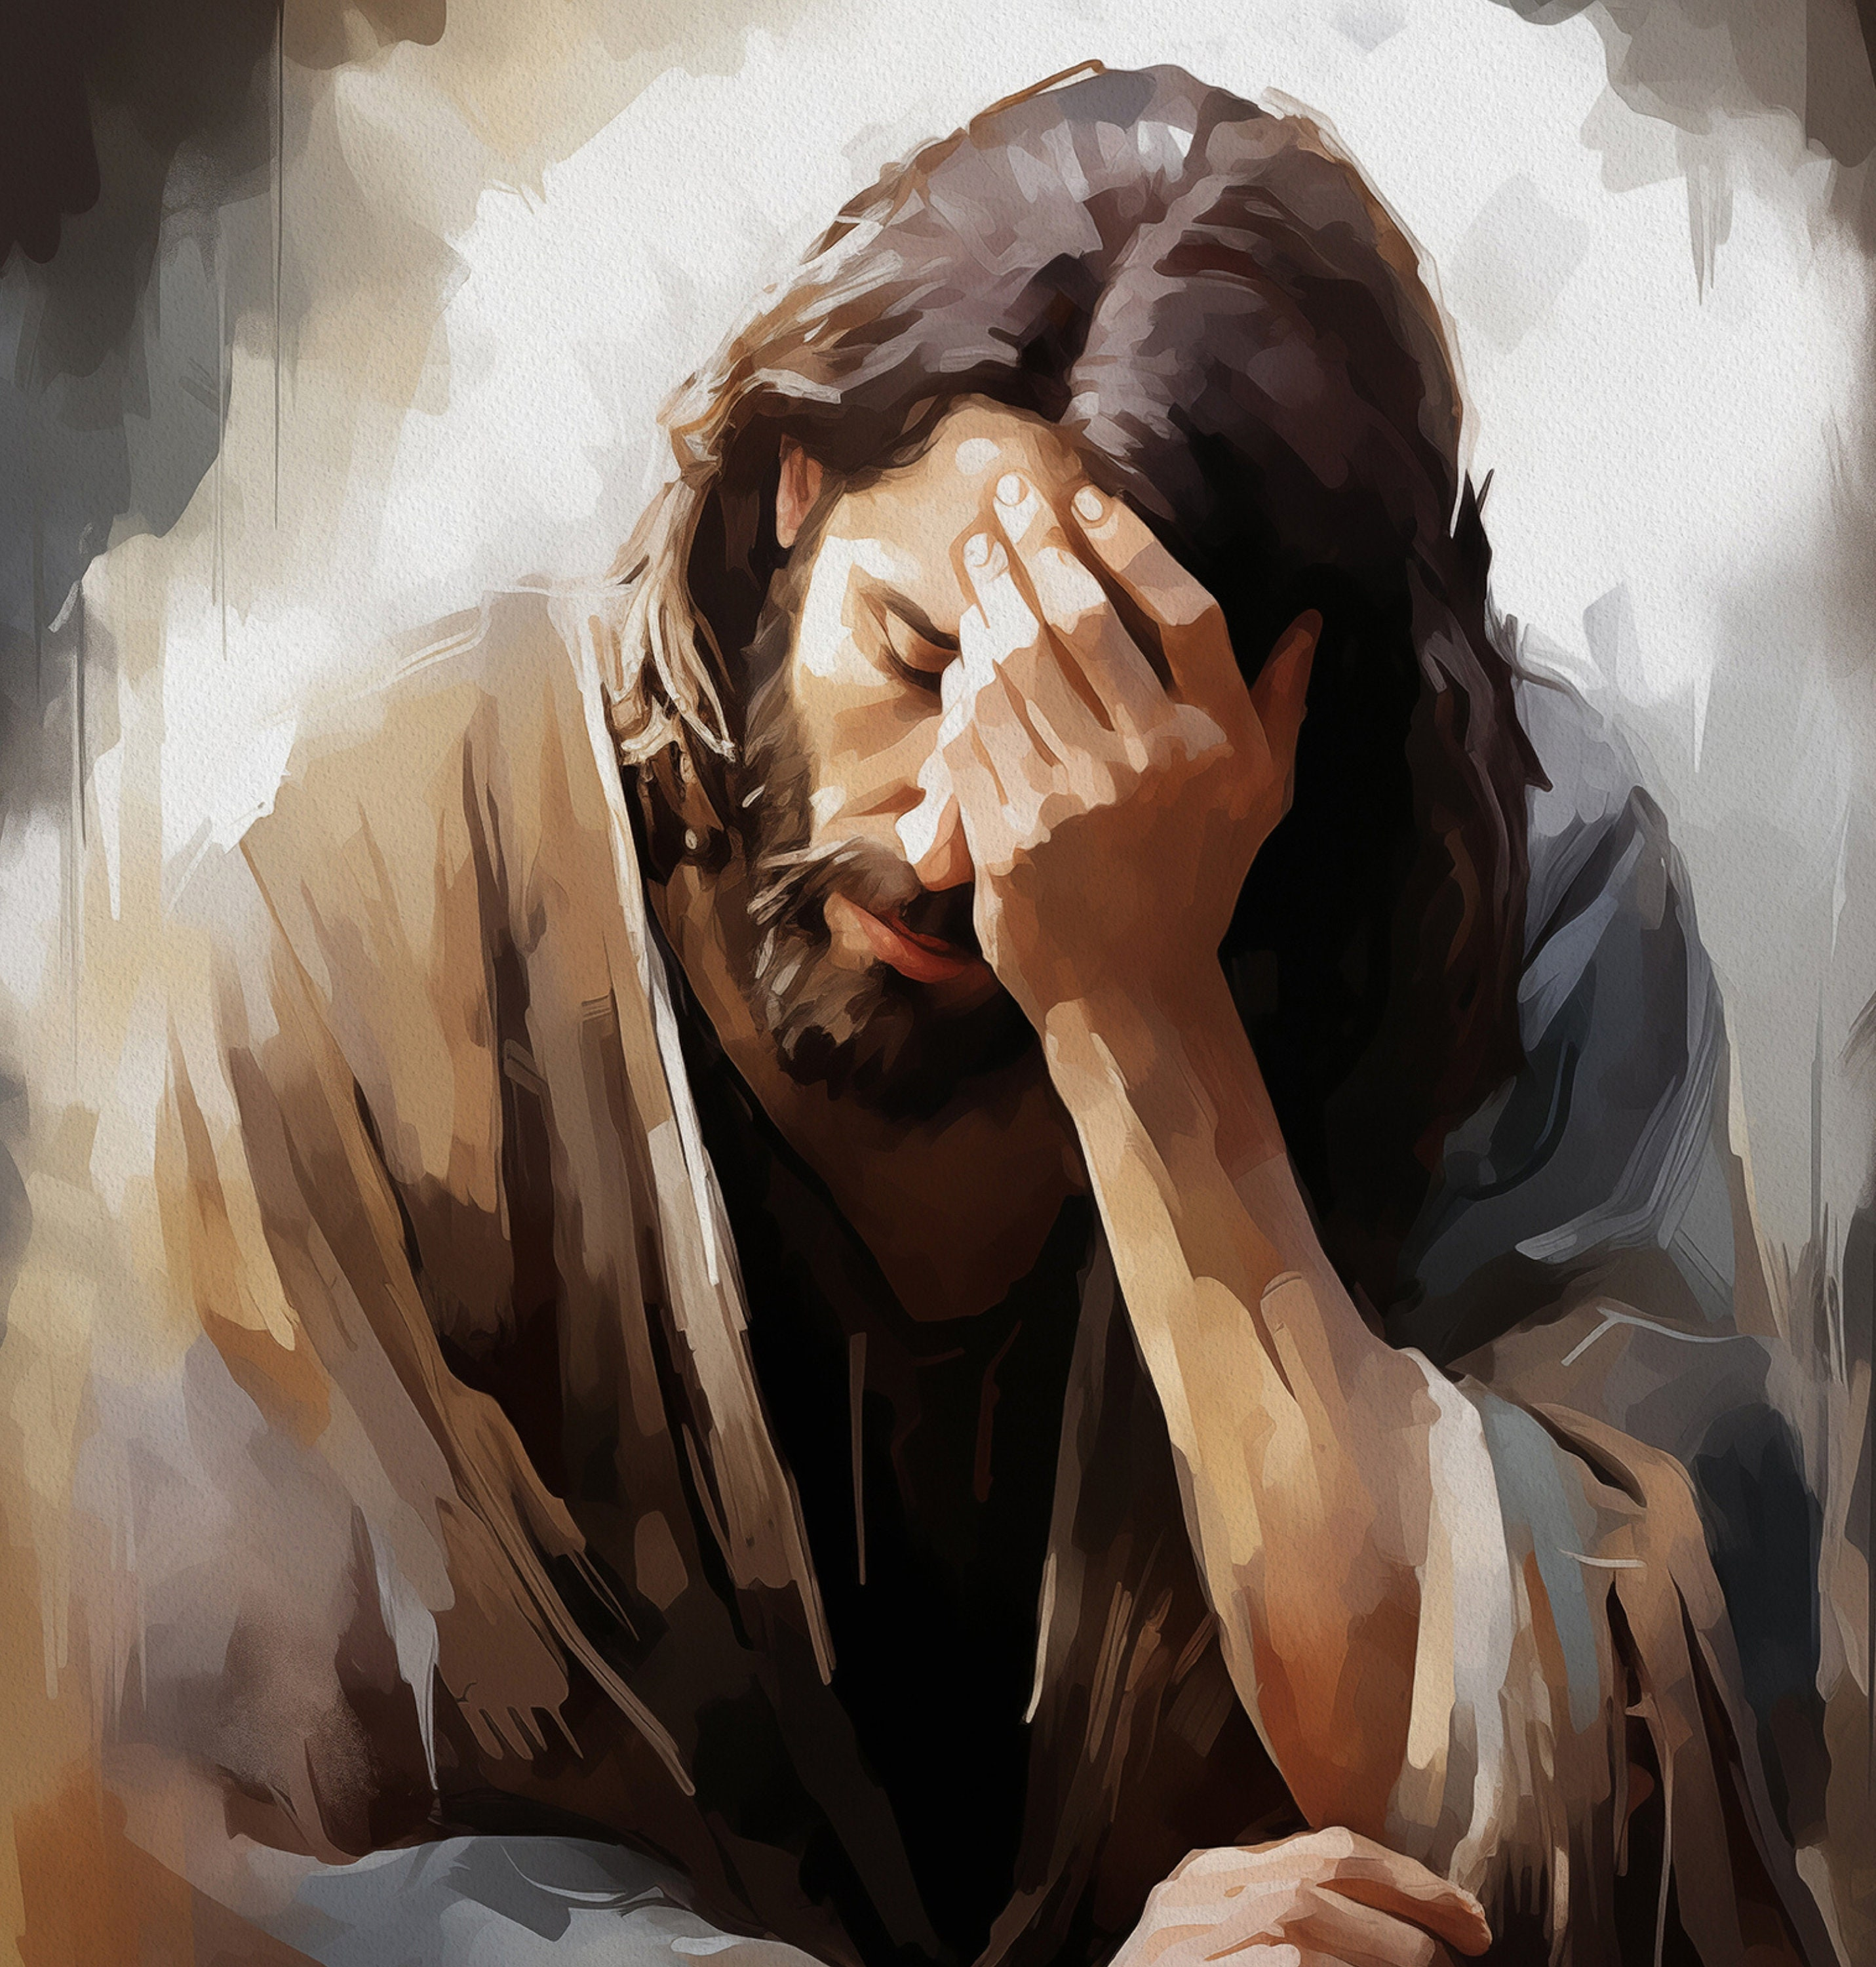
The Desire of Ages
Pg. 575
“Jesus gazes upon the scene, and the vast multitude hush their shouts, spellbound by the sudden vision of beauty. All eyes turn upon the Saviour, expecting to see in His countenance the admiration they themselves feel. But instead of this they behold a cloud of sorrow.”

Slide 17
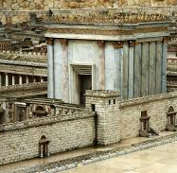
The Desire of Ages
Pg. 576
“It was the sight of Jerusalem that pierced the heart of Jesus—Jerusalem that had rejected the Son of God and scorned His love, that refused to be convinced by His mighty miracles, and was about to take His life.”

Slide 18
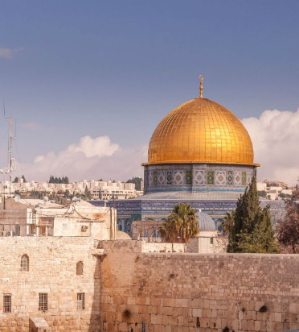
The Desire of Ages
Pg. 575
He saw what she was in her guilt of rejecting her Redeemer, and what she might have been had she accepted Him who alone could heal her wound. He had come to save her; how could He give her up?

Slide 19
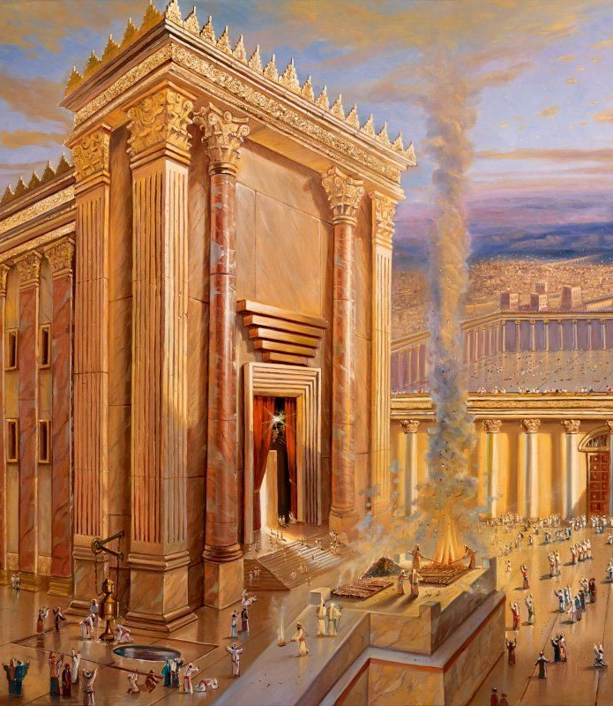
The Desire of Ages
Pg. 575
Israel had been a favored people; God had made their temple His habitation; it was “beautiful for situation, the joy of the whole earth.” Psalm 48:2. The record of more than a thousand years of Christ's guardian care and tender love, such as a father bears his only child, was there.

Slide 20
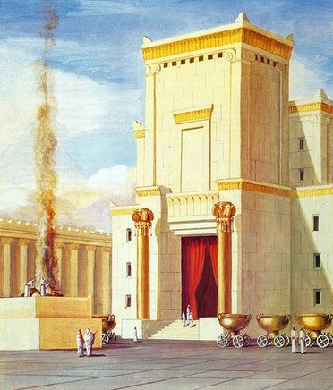
The Desire of Ages
Pg. 575
“Jerusalem had been the child of His care, and as a tender father mourns over a wayward son, so Jesus wept over the beloved city. How can I give thee up? How can I see thee devoted to destruction? Must I let thee go to fill up the cup of thine iniquity? One soul is of such value that, in comparison with it, worlds sink into insignificance;

Slide 21
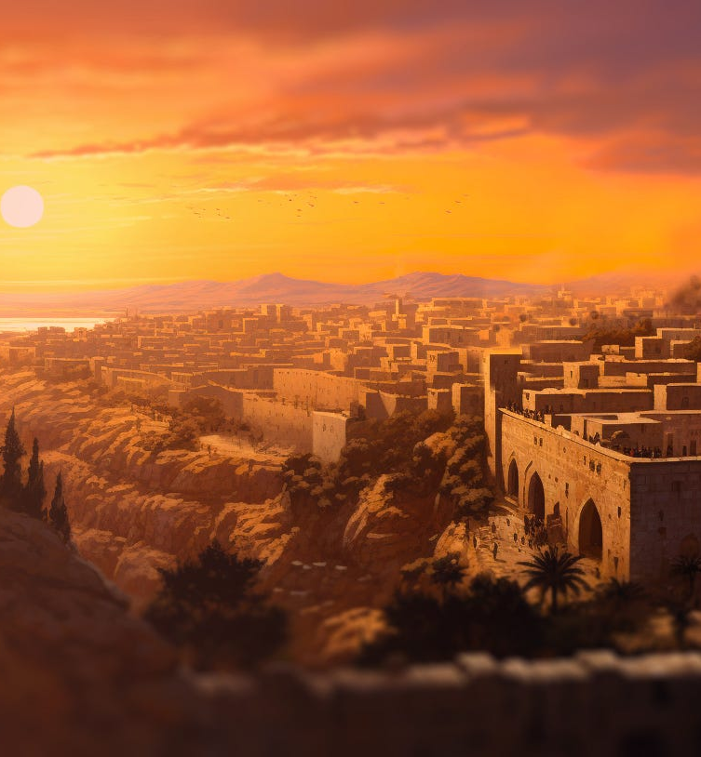
The Desire of Ages
Pg. 575
but here was a whole nation to be lost. When the fast westering sun should pass from sight in the heavens, Jerusalem's day of grace would be ended. While the procession was halting on the brow of Olivet, it was not yet too late for Jerusalem to repent.”

Slide 22
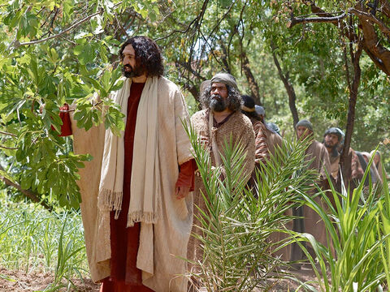
The Cursed Tree
Mark 11:12-26
12 And on the morrow, when they were come from Bethany, he was hungry:

Slide 23
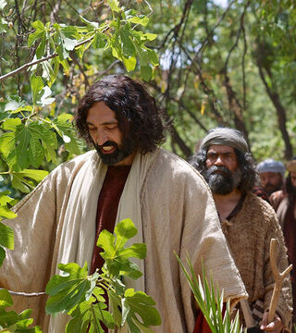
The Cursed Tree
Mark 11:13-26
13 And seeing a fig tree afar off having leaves, he came, if haply he might find any thing thereon: and when he came to it, he found nothing but leaves; for the time of figs was not yet.

Slide 24
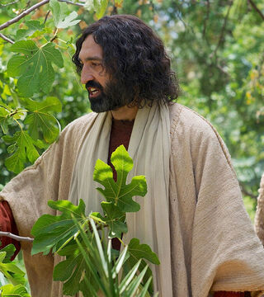
The Cursed Tree
Mark 11:14-26
14 And Jesus answered and said unto it, No man eat fruit of thee hereafter for ever. And his disciples heard it.

Slide 25
It was not the season for ripe figs, except in certain localities; and on the highlands about Jerusalem it might truly be said, “The time of figs was not yet.” But in the orchard to which Jesus came, one tree appeared to be in advance of all the others. It was already covered with leaves.
The Desire of Ages p. 581

Slide 26
It was already covered with leaves. It is the nature of the fig tree that before the leaves open, the growing fruit appears. Therefore this tree in full leaf gave promise of well-developed fruit.
The Desire of Ages p. 581

Slide 27
But its appearance was deceptive. Upon searching its branches, from the lowest bough to the topmost twig, Jesus found “nothing but leaves.” It was a mass of pretentious foliage, nothing more.
The Desire of Ages p. 581

Slide 28
Christ's act in cursing the fig tree had astonished the disciples. It seemed to them unlike His ways and works. Often they had heard Him declare that He came not to condemn the world, but that the world through Him might be saved.
The Desire of Ages p. 582

Slide 29
They remembered His words, “The Son of man is not come to destroy men's lives, but to save them.” Luke 9:56. His wonderful works had been done to restore, never to destroy.
The Desire of Ages p. 582

Slide 30
The disciples had known Him only as the Restorer, the Healer. This act stood alone. What was its purpose? they questioned.
The Desire of Ages p. 582

Slide 31
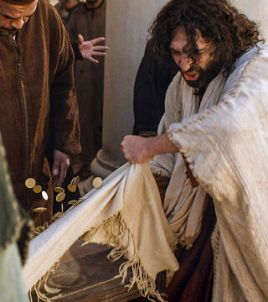
The Cursed Tree
Mark 11:15-26
15 And they come to Jerusalem: and Jesus went into the temple, and began to cast out them that sold and bought in the temple, and overthrew the tables of the moneychangers, and the seats of them that sold doves;

Slide 32
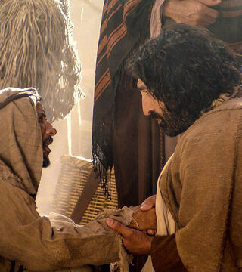
The Cursed Tree
Mark 11:16-26
16 And would not suffer that any man should carry any vessel through the temple.

Slide 33
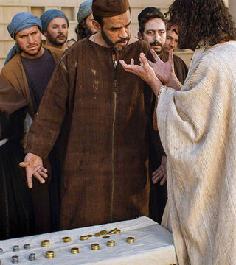
The Cursed Tree
Mark 11:17-26
17 And he taught, saying unto them, Is it not written, My house shall be called of all nations the house of prayer? but ye have made it a den of thieves.

Slide 34
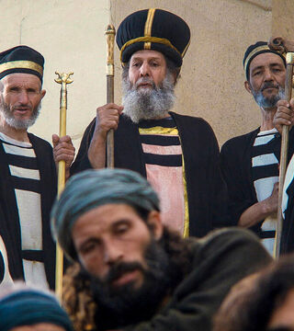
The Cursed Tree
Mark 11:18-26
18 And the scribes and chief priests heard it, and sought how they might destroy him: for they feared him, because all the people was astonished at his doctrine.

Slide 35
SDABC
On Matthew 21:14
“In the triumphal procession the day before, the trophies that Jesus’ healing power had rescued from the oppression of Satan had marched along shouting the Savior’s praises. As Jesus set about healing those who now flocked to Him in the Temple courts, He gave a practical demonstration of the truth that the Temple had been ordained of God to serve man’s need, not his greed.”

Slide 36
SDABC
On Matthew 21:14
“It seems that for a brief time Jesus was in complete control of the Temple, and during the time demonstrated, in part, how these sacred precincts should be used. He had come to earth that men “might have life, and that they might have it more abundantly,” not that they might sacrifice more abundantly or make profits more abundantly.”

Slide 37
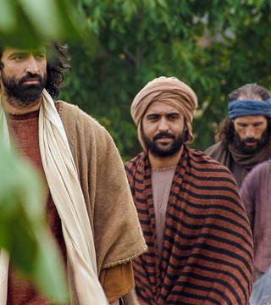
The Cursed Tree
Mark 11:19-26
19 And when even was come, he went out of the city.

Slide 38
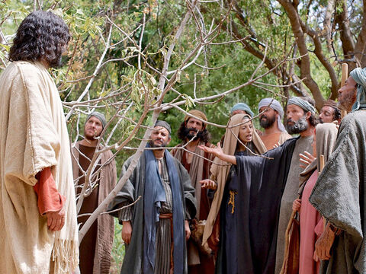
The Cursed Tree
Mark 11:20-26
20 And in the morning, as they passed by, they saw the fig tree dried up from the roots.

Slide 39
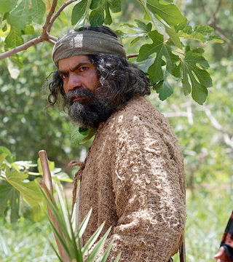
The Cursed Tree
Mark 11:21-26
21 And Peter calling to remembrance saith unto him, Master, behold, the fig tree which thou cursedst is withered away.

Slide 40
The cursing of the fig tree was an acted parable. That barren tree, flaunting its pretentious foliage in the very face of Christ, was a symbol of the Jewish nation.
The Desire of Ages p. 582

Slide 41
The Saviour desired to make plain to His disciples the cause and the certainty of Israel's doom. For this purpose He invested the tree with moral qualities, and made it the expositor of divine truth.
The Desire of Ages p. 582

Slide 42
The Jews stood forth distinct from all other nations, professing allegiance to God. They had been specially favored by Him, and they laid claim to righteousness above every other people.
The Desire of Ages p. 582

Slide 43
But they were corrupted by the love of the world and the greed of gain. They boasted of their knowledge, but they were ignorant of the requirements of God, and were full of hypocrisy.
The Desire of Ages p. 582

Slide 44
Like the barren tree, they spread their pretentious branches aloft, luxuriant in appearance, and beautiful to the eye, but they yielded “nothing but leaves.”
The Desire of Ages p. 582

Slide 45
The Jewish religion, with its magnificent temple, its sacred altars, its mitered priests and impressive ceremonies, was indeed fair in outward appearance, but humility, love, and benevolence were lacking.
The Desire of Ages p. 582

Slide 46
All the trees in the fig orchard were destitute of fruit; but the leafless trees raised no expectation, and caused no disappointment. By these trees the Gentiles were represented.
The Desire of Ages p. 583

Slide 47
They were as destitute as were the Jews of godliness; but they had not professed to serve God. They made no boastful pretensions to goodness. They were blind to the works and ways of God.
The Desire of Ages p. 583

Slide 48
With them the time of figs was not yet. They were still waiting for a day which would bring them light and hope.
The Desire of Ages p. 583

Slide 49
The Jews, who had received greater blessings from God, were held accountable for their abuse of these gifts. The privileges of which they boasted only increased their guilt.
The Desire of Ages p. 583

Slide 50
The Cursed Tree
Mark 11:22-26
22 And Jesus answering saith unto them, Have faith in God.

Slide 51
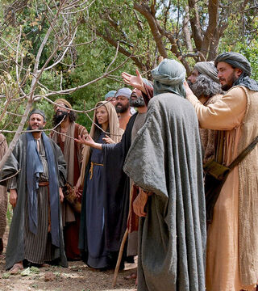
The Cursed Tree
Mark 11:23-26
23 For verily I say unto you, That whosoever shall say unto this mountain, Be thou removed, and be thou cast into the sea; and shall not doubt in his heart, but shall believe that those things which he saith shall come to pass; he shall have whatsoever he saith.

Slide 52
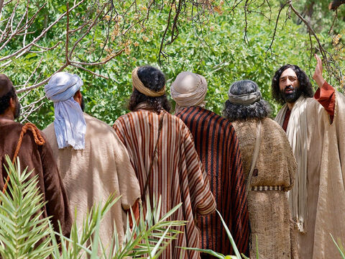
The Cursed Tree
Mark 11:24-26
24 Therefore I say unto you, What things soever ye desire, when ye pray, believe that ye receive them, and ye shall have them.

Slide 53
The Cursed Tree
Mark 11:25-26
25 And when ye stand praying, forgive, if ye have ought against any: that your Father also which is in heaven may forgive you your trespasses.

Slide 54
The Cursed Tree
Mark 11:26
26 But if ye do not forgive, neither will your Father which is in heaven forgive your trespasses.

Slide 55
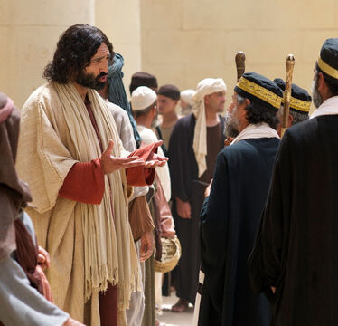
Authority
Mark 11:27-33
27 And they come again to Jerusalem: and as he was walking in the temple, there come to him the chief priests, and the scribes, and the elders,

Slide 56
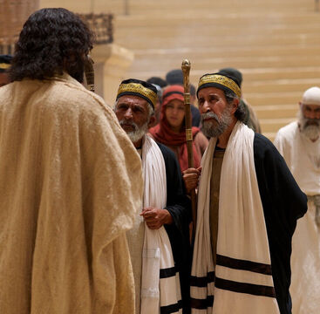
Authority
Mark 11:28-33
28 And say unto him, By what authority doest thou these things? and who gave thee this authority to do these things?

Slide 57
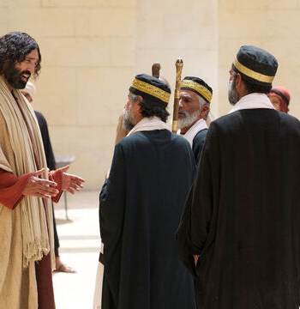
Authority
Mark 11:29-33
29 And Jesus answered and said unto them, I will also ask of you one question, and answer me, and I will tell you by what authority I do these things.

Slide 58
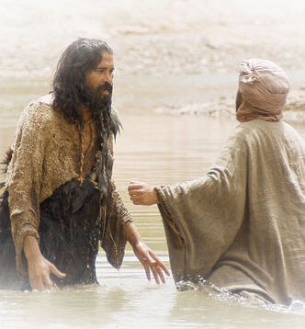
Authority
Mark 11:30-33
30 The baptism of John, was it from heaven, or of men? answer me.

Slide 59
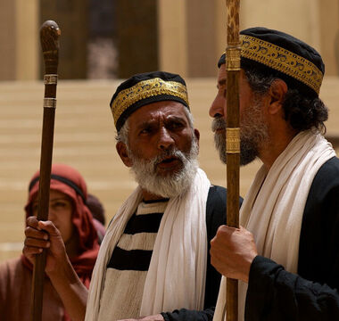
Authority
Mark 11:31-33
31 And they reasoned with themselves, saying, If we shall say, From heaven; he will say, Why then did ye not believe him?

Slide 60
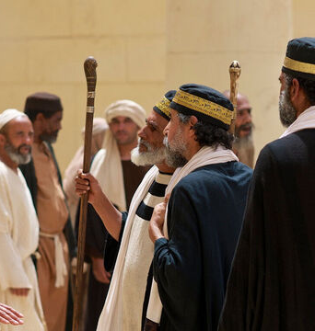
Authority
Mark 11:32-33
32 But if we shall say, Of men; they feared the people: for all men counted John, that he was a prophet indeed.

Slide 61
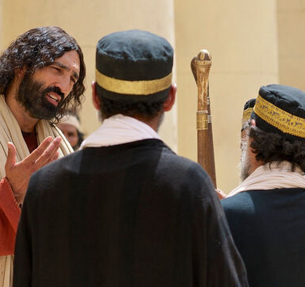
Authority
Mark 11:33
33 And they answered and said unto Jesus, We cannot tell. And Jesus answering saith unto them, Neither do I tell you by what authority I do these things.

Slide 62
SDABC on Matthew 21:27
“
“The Jewish leaders must certainly have known that John was a prophet, but to escape a dilemma they took refuge in professed ignorance. Even so, they did not escape unscathed.”
”

Slide 63
SDABC on Matthew 21:27
“
“Their answer to Jesus’ question automatically canceled their right to press Him for an answer to their original question, and this accounts for the fact that they did not continue to urge the demand. Furthermore, they forfeited the respect of the people.”
”

Slide 64
SDABC on Matthew 21:27
“
“They were inextricably entangled in the net they had so cleverly spread for Jesus. Jesus had tested their professed ability to evaluate divine credentials, and they had miserably failed. They had, for practical purposes, abdicated their claim to be the spiritual leaders of the nation.”
”

Slide 65
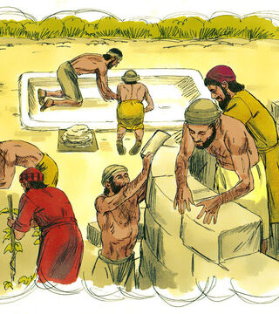
Wicked Husbandmen
Mark 12:1-12
And he began to speak unto them by parables. A certain man planted a vineyard, and set an hedge about it, and digged a place for the winefat, and built a tower, and let it out to husbandmen, and went into a far country.

Slide 66
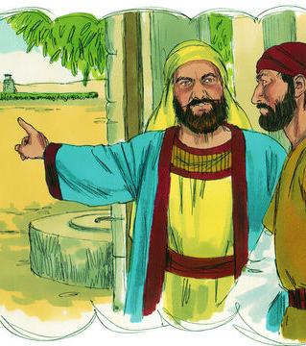
Wicked Husbandmen
Mark 12:2-12
2 And at the season he sent to the husbandmen a servant, that he might receive from the husbandmen of the fruit of the vineyard.

Slide 67
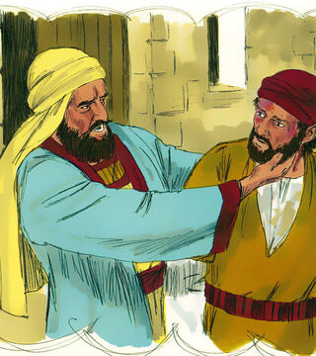
Wicked Husbandmen
Mark 12:3-12
3 And they caught him, and beat him, and sent him away empty.

Slide 68
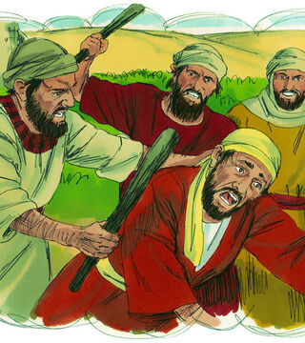
Wicked Husbandmen
Mark 12:4-12
4 And again he sent unto them another servant; and at him they cast stones, and wounded him in the head, and sent him away shamefully handled.

Slide 69
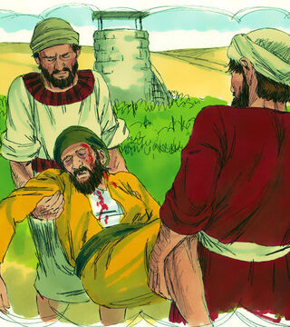
Wicked Husbandmen
Mark 12:5-12
5 And again he sent another; and him they killed, and many others; beating some, and killing some.

Slide 70
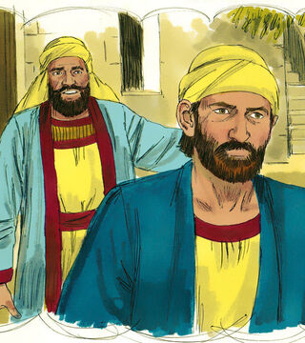
Wicked Husbandmen
Mark 12:6-12
6 Having yet therefore one son, his wellbeloved, he sent him also last unto them, saying, They will reverence my son.

Slide 71
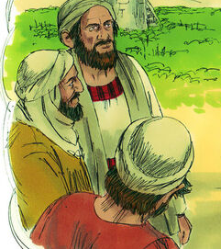
Wicked Husbandmen
Mark 12:7-12
7 But those husbandmen said among themselves, This is the heir; come, let us kill him, and the inheritance shall be ours.'

Slide 72
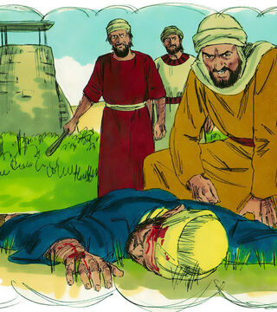
Wicked Husbandmen
Mark 12:8-12
8 And they took him, and killed him, and cast him out of the vineyard.

Slide 73
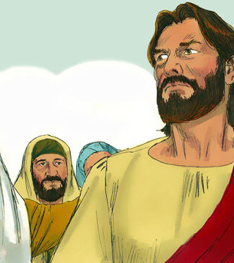
Wicked Husbandmen
Mark 12:9-12
9 What shall therefore the lord of the vineyard do? he will come and destroy the husbandmen, and will give the vineyard unto others.

Slide 74
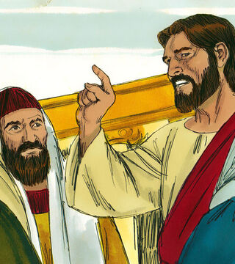
Wicked Husbandmen
Mark 12:10-12
10 And have ye not read this scripture; The stone which the builders rejected is become the head of the corner:

Slide 75
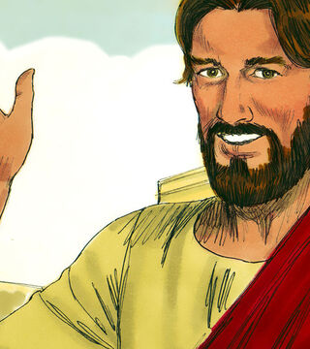
Wicked Husbandmen
Mark 12:11-12
11 This was the Lord's doing, and it is marvellous in our eyes?

Slide 76
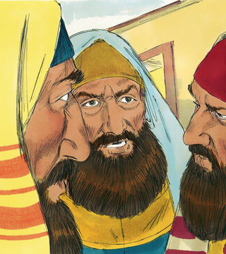
Wicked Husbandmen
Mark 12:12
12 And they sought to lay hold on him, but feared the people: for they knew that he had spoken the parable against them: and they left him, and went their way.

Slide 77
In quoting the prophecy of the rejected stone, Christ referred to an actual occurrence in the history of Israel. The incident was connected with the building of the first temple.
The Desire of Ages p. 597

Slide 78
While it had a special application at the time of Christ's first advent, and should have appealed with special force to the Jews, it has also a lesson for us. When the temple of Solomon was erected, the immense stones for the walls and the foundation were entirely prepared at the quarry;
The Desire of Ages p. 597

Slide 79
after they were brought to the place of building, not an instrument was to be used upon them; the workmen had only to place them in position. For use in the foundation, one stone of unusual size and peculiar shape had been brought; but the workmen could find no place for it, and would not accept it.
The Desire of Ages p. 597

Slide 80
It was an annoyance to them as it lay unused in their way. Long it remained a rejected stone. But when the builders came to the laying of the corner, they searched for a long time to find a stone of sufficient size and strength, and of the proper shape, to take that particular place, and bear the great weight which would rest upon it.
The Desire of Ages p. 597

Slide 81
Should they make an unwise choice for this important place, the safety of the entire building would be endangered. They must find a stone capable of resisting the influence of the sun, of frost, and of tempest.
The Desire of Ages p. 597

Slide 82
Several stones had at different times been chosen, but under the pressure of immense weights they had crumbled to pieces. Others could not bear the test of the sudden atmospheric changes.
The Desire of Ages p. 597

Slide 83
But at last attention was called to the stone so long rejected. It had been exposed to the air, to sun and storm, without revealing the slightest crack. The builders examined this stone. It had borne every test but one.
The Desire of Ages p. 597

Slide 84
If it could bear the test of severe pressure, they decided to accept it for the cornerstone. The trial was made. The stone was accepted, brought to its assigned position, and found to be an exact fit. In prophetic vision, Isaiah was shown that this stone was a symbol of Christ.
The Desire of Ages p. 597

Slide 85
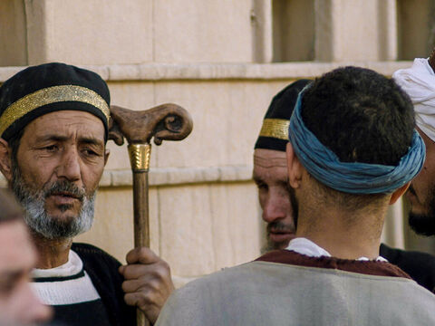
Pharisees and Herodians: Mark 12:13-17
13 And they send unto him certain of the Pharisees and of the Herodians, to catch him in his words.
The Herodians were a Jewish political party that favored the house of Herod Antipas. The Pharisees were ardent nationalists, who opposed Herod as well as Caesar, whereas the Herodian partisans were collaborationists. Bitter enemies in the realm of politics, they were united against Jesus.

Slide 86
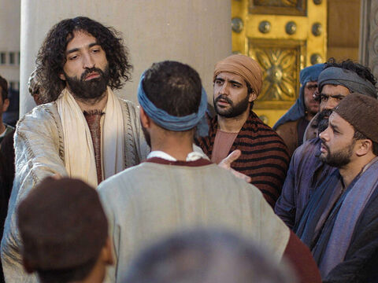
Pharisees and Herodians: Mark 12:14-17
14 And when they were come, they say unto him, Master, we know that thou art true, and carest for no man: for thou regardest not the person of men, but teachest the way of God in truth: Is it lawful to give tribute to Caesar, or not?
Their simulated honesty was in fact an attempt at deception. By flattery they hoped to put Jesus off His guard. They hereby profess to credit Jesus with being fair and impartial.

Slide 87

Pharisees and Herodians: Mark 12:15-17
15 Shall we give, or shall we not give? But he, knowing their hypocrisy, said unto them, Why tempt ye me? bring me a penny, that I may see it.
The politically explosive question that confronted Jesus involved the problem, “Shall we submit to Rome or shall we fight for our independence?”

Slide 88

Pharisees and Herodians: Mark 12:16-17
16 And they brought it. And he saith unto them, Whose is this image and superscription? And they said unto him, Caesar's.
Roman taxes must be paid in Roman coin. Local rulers were permitted to issue their own copper coins, but Rome reserved the right to mint silver coins.

Slide 89

Pharisees and Herodians: Mark 12:17
17 And Jesus answering said unto them, Render to Caesar the things that are Caesar's, and to God the things that are God's. And they marvelled at him.
Roman taxes must be paid in Roman coin. Local rulers were permitted to issue their own copper coins, but Rome reserved the right to mint silver coins.

Slide 90

Pharisees
Mark 12:18-27
18 Then come unto him the Sadducees, which say there is no resurrection; and they asked him, saying,

Slide 91

Pharisees
Mark 12:19-27
19 Master, Moses wrote unto us, If a man's brother die, and leave his wife behind him, and leave no children, that his brother should take his wife, and raise up seed unto his brother.

Slide 92

Pharisees
Mark 12:20-27
20 Now there were seven brethren: and the first took a wife, and dying left no seed.
21 And the second took her, and died, neither left he any seed: and the third likewise.
22 And the seven had her, and left no seed: last of all the woman died also.

Slide 93

Pharisees
Mark 12:23-27
23 In the resurrection therefore, when they shall rise, whose wife shall she be of them? for the seven had her to wife.
24 And Jesus answering said unto them, Do ye not therefore err, because ye know not the scriptures, neither the power of God?

Slide 94

Pharisees
Mark 12:25-27
25 For when they shall rise from the dead, they neither marry, nor are given in marriage; but are as the angels which are in heaven.

Slide 95

Pharisees
Mark 12:26-27
26 And as touching the dead, that they rise: have ye not read in the book of Moses, how in the bush God spake unto him, saying, I am the God of Abraham, and the God of Isaac, and the God of Jacob?

Slide 96

Pharisees
Mark 12:27
27 He is not the God of the dead, but the God of the living: ye therefore do greatly err.

Slide 97

Scribes
Mark 12:28-34
28 And one of the scribes came, and having heard them reasoning together, and perceiving that he had answered them well, asked him, Which is the first commandment of all?

Slide 98

Scribes
Mark 12:29-34
29 And Jesus answered him, The first of all the commandments is, Hear, O Israel; The Lord our God is one Lord:

Slide 99

Scribes
Mark 12:30-34
30 And thou shalt love the Lord thy God with all thy heart, and with all thy soul, and with all thy mind, and with all thy strength: this is the first commandment.

Slide 100

Scribes
Mark 12:31-34
31 And the second is like, namely this, Thou shalt love thy neighbour as thyself. There is none other commandment greater than these.

Slide 101

Scribes
Mark 12:32-34
32 And the scribe said unto him, Well, Master, thou hast said the truth: for there is one God; and there is none other but he:

Slide 102

Scribes
Mark 12:33-34
33 And to love him with all the heart, and with all the understanding, and with all the soul, and with all the strength, and to love his neighbour as himself, is more than all whole burnt offerings and sacrifices.

Slide 103

Scribes
Mark 12:34
34 And when Jesus saw that he answered discreetly, he said unto him, Thou art not far from the kingdom of God. And no man after that durst ask him any question.

Slide 104

Jesus Poses Questions
Mark 12:35-40
35 And Jesus answered and said, while he taught in the temple, How say the scribes that Christ is the son of David?

Slide 105
Jesus Poses Questions
Mark 12:36-40
36 For David himself said by the Holy Ghost, The Lord said to my Lord, Sit thou on my right hand, till I make thine enemies thy footstool.

Slide 106

Jesus Poses Questions
Mark 12:37-40
37 David therefore himself calleth him Lord; and whence is he then his son? And the common people heard him gladly.

Slide 107
SDABC on Matthew 22:45
“
“In other words, if David calls Messiah “Lord,” implying that Messiah is older than David himself, how can Messiah also be David’s “Son,” and thus be younger than David?”
”

Slide 108
SDABC on Matthew 22:45
“
“The only possible answer to Jesus’ question is that the One who was to come as Messiah would have existed prior to His incarnation on this earth. As David’s “Lord,” Messiah was none other than the Son of God; as David’s “Son,” Messiah was the Son of man.”
”

Slide 109
SDABC on Matthew 22:45
“
Obviously the Jewish leaders were unprepared to answer this question because of their erroneous concepts of the Messiah. They could not very well answer the question without admitting that Jesus of Nazareth was the Messiah, the Son of God.
”

Slide 110
SDABC on Matthew 22:45
“
In asking this question, then, Jesus brought the Pharisees and scribes face to face with the central idea of His mission to earth, for this question would undoubtedly, if faced sincerely and intelligently, have led to the recognition of His Messiahship.
”

Slide 111

Jesus Poses Questions
Mark 12:38-40
38 And he said unto them in his doctrine, Beware of the scribes, which love to go in long clothing, and love salutations in the marketplaces,

Slide 112

Jesus Poses Questions
Mark 12:39-40
39 And the chief seats in the synagogues, and the uppermost rooms at feasts:
40 Which devour widows' houses, and for a pretence make long prayers: these shall receive greater damnation.

Slide 113

The Widow’s Mite
Mark 12:41-44
41 And Jesus sat over against the treasury, and beheld how the people cast money into the treasury: and many that were rich cast in much.

Slide 114

The Widow’s Mite
Mark 12:42-44
42 And there came a certain poor widow, and she threw in two mites, which make a farthing.

Slide 115

The Widow’s Mite
Mark 12:43-44
43 And he called unto him his disciples, and saith unto them, Verily I say unto you, That this poor widow hath cast more in, than all they which have cast into the treasury:

Slide 116

The Widow’s Mite
Mark 12:44
44 For all they did cast in of their abundance; but she of her want did cast in all that she had, even all her living.

Slide 117
Thank you!
Happy Sabbath!!

